Slide 1
“Diversity and Adaptation”
Collaboration between
School and Parents
Towards Equity in Family Engagement.
More is Needed than a Good policy
Áine Lynch
CEO
National Parents Council-Ireland

Slide 2
Overview
Next hour and 15 mins = 5 mini presentations
National Parents Council Primary
Partnership Schools
Children’s Voice
Parents’ Voice
Teacher Training

Slide 3

National Parents Council Primary
Primary and Early Years
Registered Charity and Company Ltd by Guarantee
Diverse income streams – 2/3rds approx is State funding
Services – Helpline, Training, Website, Partnership Schools Ireland
Representative Voice

Slide 4




Partnership Schools Ireland

Slide 5
Effective Partnerships lead to better outcomes for Children
Excellent
Schools
Strong
Families
Healthy
Communities

Slide 6

Action Team for Partnership
Action arm of a School Board of Management
Possible members: school staff, Principal, Parents, Community members, Pupils, BOM members
Annual Action Plan based on School Plan Goals
2 Academic Goals, 1 Behaviour Goal, 1 Partnership Goal

Slide 7
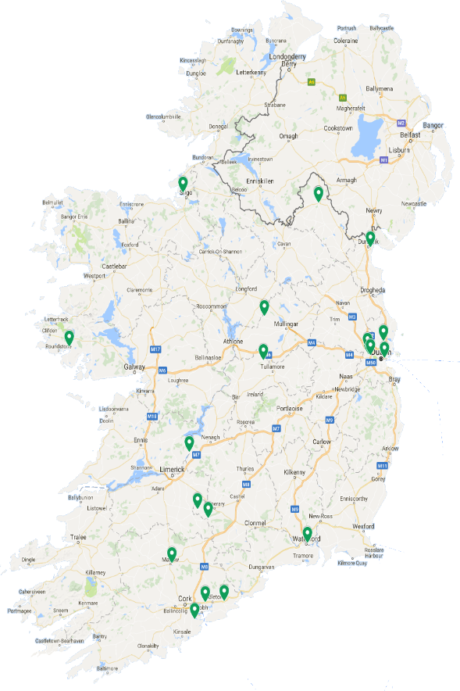
Big concept
Currently
25 Partnership Schools all around Ireland and recruiting
Special School
Rural and Urban

Slide 8

Children’s Voice
NPC’s Children’s
Participation Unit
Partnership Schools Ireland
Children’s Surveys
Face to Face Consultation

Slide 9


Children’s Surveys
2016-2017
9000 Responses
NPC’s Strategic Planning
  1039 responses
What it is like to be a child in Ireland
  2091 responses
Children’s views on Homework
  2330 responses
Children’s experience of Lunchtime in school
  3493

Slide 10

What they said!
“I don’t like when people hit me or tell jokes on me. The boys in my school hurt my feelings”
“There is not enough PE at schools we do not have a PE hall for wet days or much sports equipment”
“I would like my parents not to be on their phones and laptop and technology”
“I would like my parents to ask more questions regarding school and to ask if I am happy in what I do in school”

Slide 11

Parents’ Voice
Authentic voice in organisation gives huge strategic advantage
Parent Assemblies
Database
Surveys

Slide 12

Parents’ Surveys
Since 2014 we have received 28,500 survey responses from parents on issues such as:
  Cost of education
  Homework
  Children’s Mental Health
  Internet Safety
  Bullying in Schools

Slide 13

Teacher Training
Undergraduate Elective for Bachelor of Education Degree.
Working with Parents to Support their Children’s Learning
Third year delivered
22 weeks over two semesters
Delivered by NPC staff

Slide 14
Course Content Overview
Values and beliefs
Research
Literacy and Numeracy
Communication-Active Listening
Communication –Restorative Processes
Inclusion, Diversity and Parental Involvement
Welcoming/unwelcoming schools
Homework
Professional Practice Plan

Slide 15

Student Feedback
“It was an excellent course in the sense it resolved parental issues that would have once baffled me but now I feel more confident in this regard”.
“Brilliant course. Would be great if all B.Ed's had to do this course”.
“I really found that the course made me much more aware of how parents can be involved with children's learning. I liked the professional plan, very practical”.
“The course took away the fear of working with parents and showed us its more positive than negative”.

Slide 16
Conclusion
Have to approach improving parent and school collaboration from many angles
Goes beyond committees
Goes beyond campaigning
Real connections with all partners

Slide 17
Contact Details
Áine Lynch alynch@npc.ie
NPC website www.npc.ie

