Slide 1
City of Reykjavik
Department of Education and Youth
After-School Programs, Youth Centers
and Summer Activites
Mars 2018

Slide 2
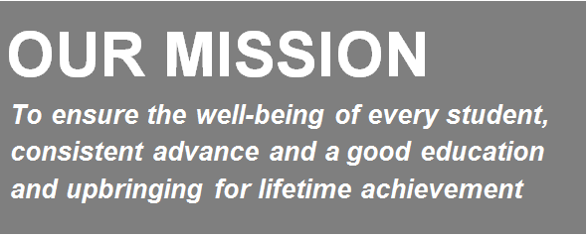
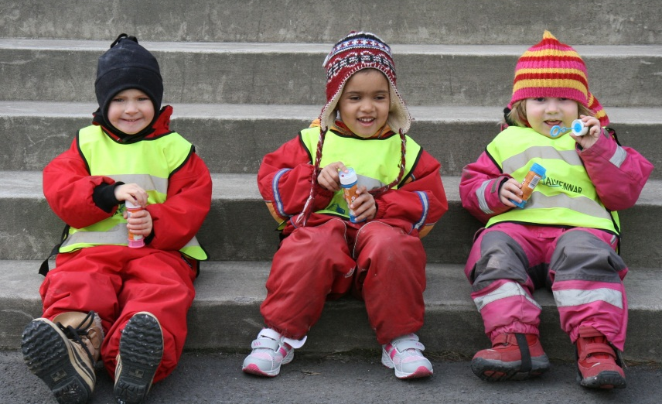

Slide 3
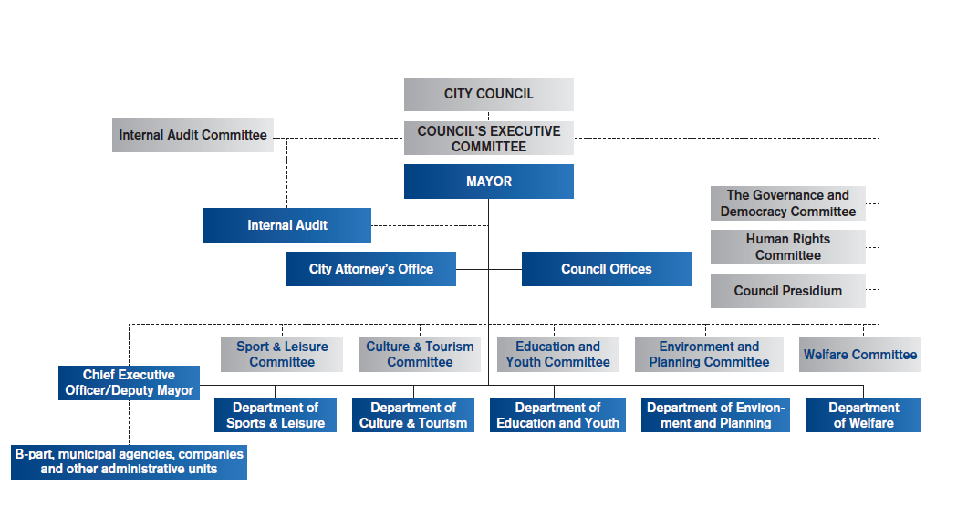

Slide 4
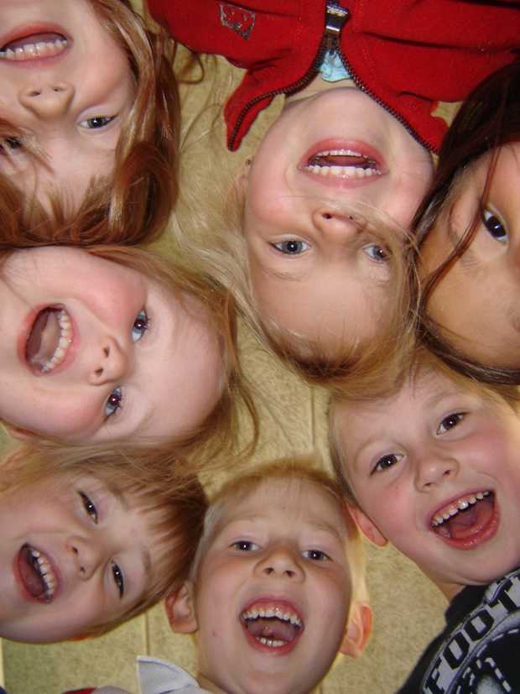
Department of Education and Youth
Preschools
Compulsory Schools
After-School Programs
Youth Centers
Community/Leisure Centers
Summer Activities
4 School Music Bands
18 Music Schools (financial support)
Adult Education

Slide 5
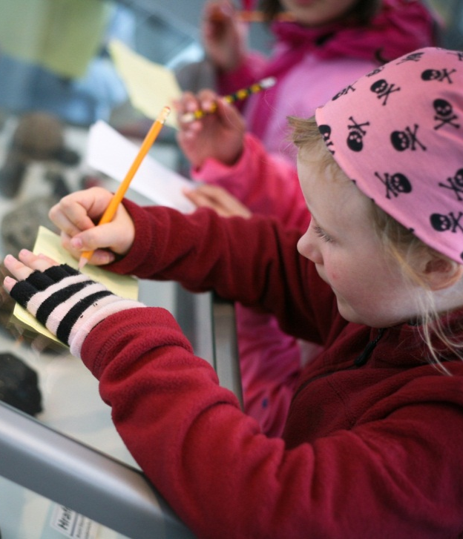
Preschools and Compulsory Schools
62 preschools
  6.000 children from 18 months to 5 years
18 independent preschools
  1.000 children from 18 months to 5 years
About 800 children from 6-18 months stay with
  200 home-daycare individuals.
36 compulsory schools
  13.600 students from 6-16 years
7 independent compulsory schools
  660 students 6-16 years

Slide 6
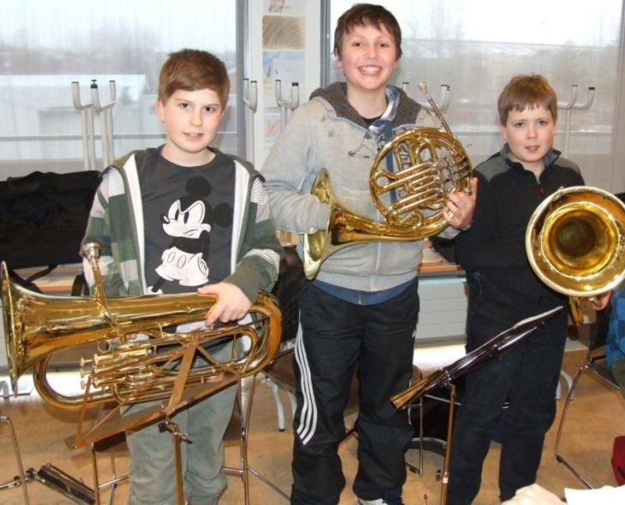
School Bands, Music Shools and Adult Education
4 school bands
  440 students learn to play an instrument
18 music schools get financial support from the community
  2.500 students
Adult Education
  250 individuals over 16 years of age receive education and 1.500 seek guidance counselling every year
Notes:
The school bands are located in a school building one in each school quarter Students gather from the neighbourhood schools to play in the bands

Slide 7
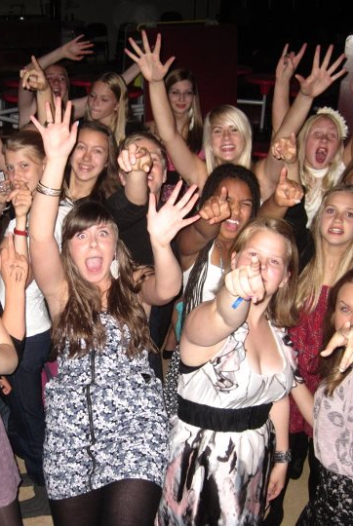
After-School Programs, Youth Centers and Summer Activites
5 Community Centers
39 afterschool programs and 4 leisure clubs
  4.600 children 6 to 9 years
21 youth centers
  120.000 attendances yearly
Variety of Summer Activites for children and youth
Notes:
The school day usually starts at 8.10 am till around 2pm Most children in the age group 6 to 9 attend after school programs while older children attend all sorts of activities like sports, music and art lessons provided by the private sectors. Some of which are supported by the community. Every family gets fixed amount monthly from the municipality in order to pay fees.
The summer activities vary from paid work to different courses which are paid for(sailing, building gymanstics etc)

Slide 8
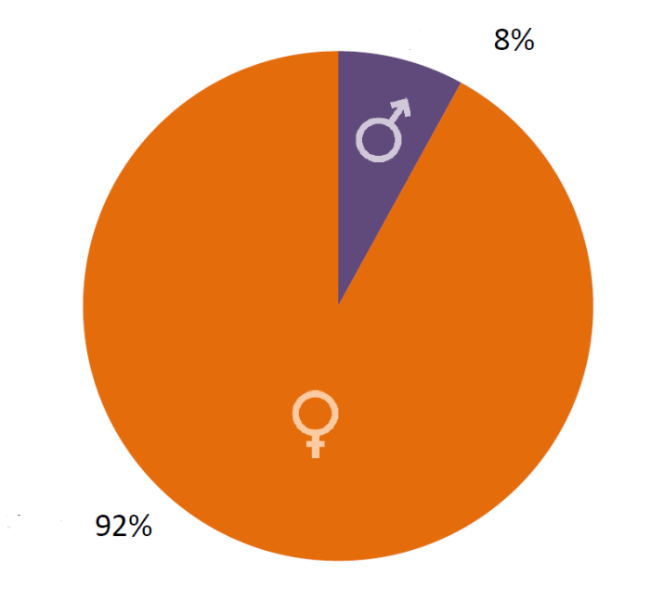
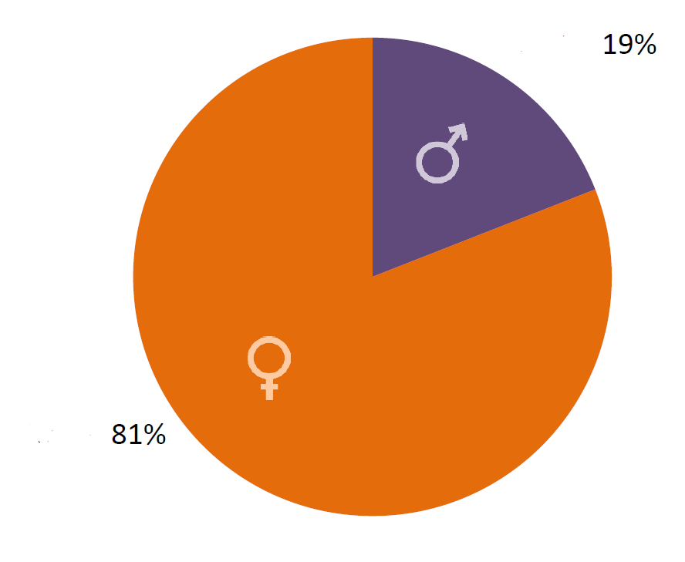
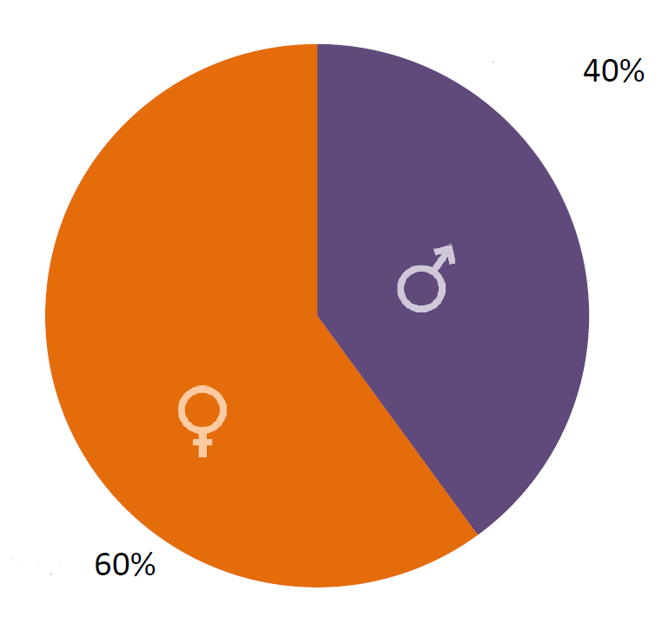
Employees - Gender Ratio
Preschools
Compulsory
schools
Youth work
Notes:
We have about 1.740 preschool and compulsory school teachers as part of our 4.300 full-time and part-time staff.
Women are:
92% of our staff in preschools
81% of our staff in compulsory schools
60% of our staff in the youth work

Slide 9
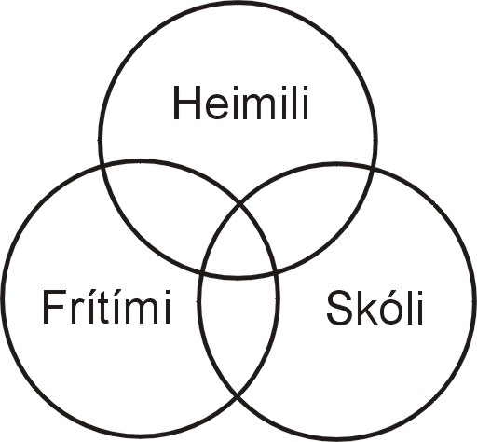
Our leisure core values
Communication skills
Social skills
Self-image
Social engagement

Slide 10
Guiding lights of Youth and Leisure
Each person can flourish and grow in an environment characterized by warmth, safety and dignity
Emphasis is placed on the development of social skills through play and work and respect for themselves, others and their environment
Use democratic practices to enhance the ability of children to develop their own choice so that they feel that they can influence their environment and conditions

Slide 11
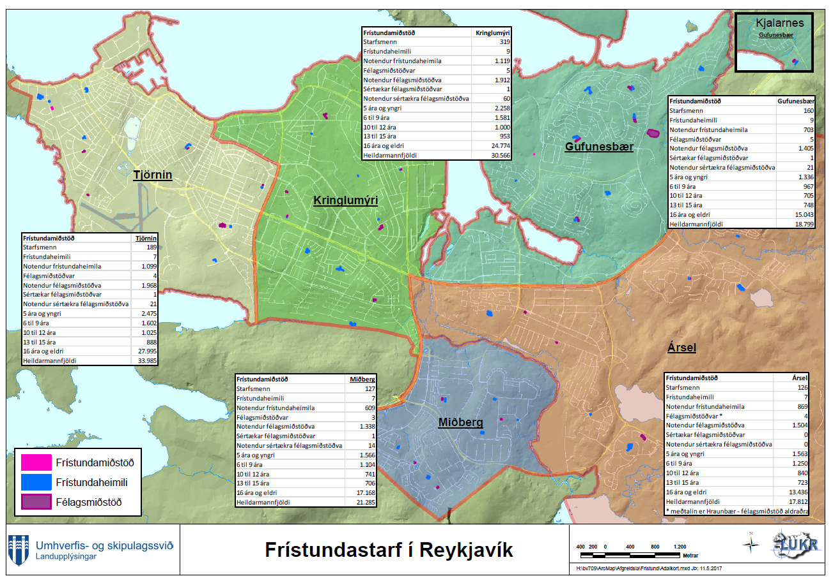

Slide 12
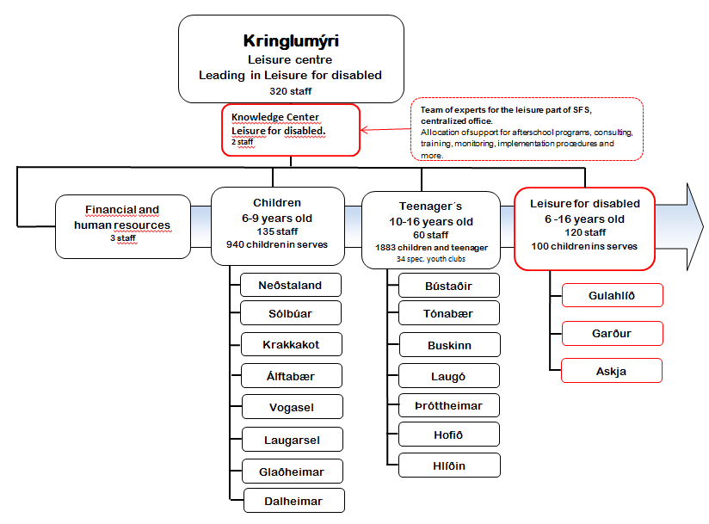
Leisure center:

Slide 13
Afterschool programs in Reykjavik
There are 39 after school programs in Reykjavik for children 6-9 year
4 of that for children age 8-9
4 youth clubs for disabled children age 10-16
approxematly 4.600 participents
from 1 day to 5 days
opening hours
5 schools are working with intergration of leisure and study in a continuous school/leisure-day
Notes:
We open when school finishis and we are open to 17:15

Slide 14
Price parents pay for afterschool program iskr -> skr
 | Price for one month | Afternoon meal
5 days | 13.060 -> 1.058 | 3.770->306
4 days | 10.650-> 863 | 3.020-> 245
3 days | 8.220-> 666 | 2.260->183
2 days | 5.800->470 | 1.520->123
1 days | 3.370->273 | 770-> 62
Whole day | 1.960-> 159 | Discounts for siblings

Slide 15
Guiding principles in leisure activities (6-16 years)
Children and adolescents should have access to leisure activities that have developmental and educational value.
Emphasis is placed on active engagement, practical experience, democracy and human rights.
Encouraging and mobilizing individuals who need special encouragement and support due to disabilities or social states will receive special consideration.
The main function of leisure centres is prevention and helping children and youth realise healthy lifestyles and to be active members of society.

Slide 16
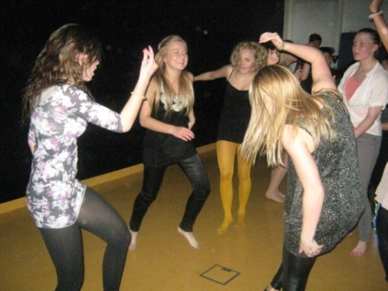
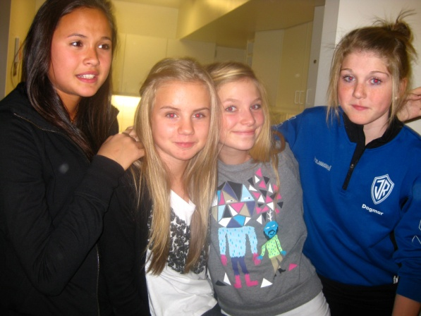

Youth club´s
The role of youth club´s is to promote positive development of young people, helping them to become more independent – both in actions and social interaction – and making them more able to face up to life’s challenges.

Slide 17
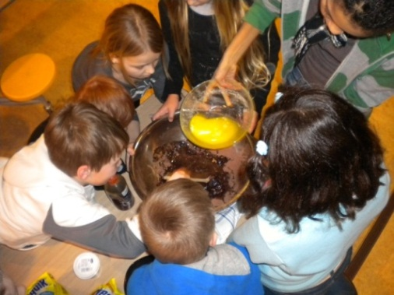
Youth club´s
Democracy
The idea is that the teenagers should influenze the schedule
The teenagers plan the activities
Empowers teenagers
Student council

Slide 18
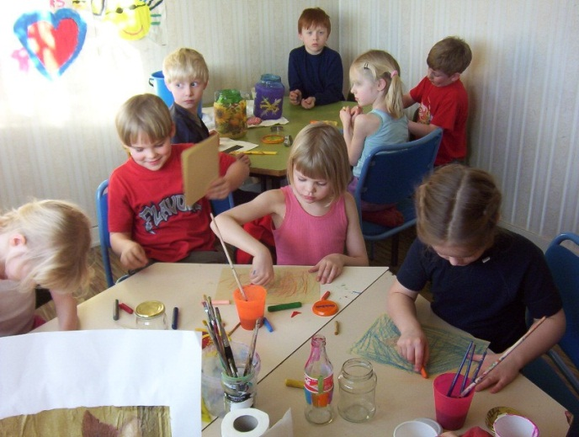
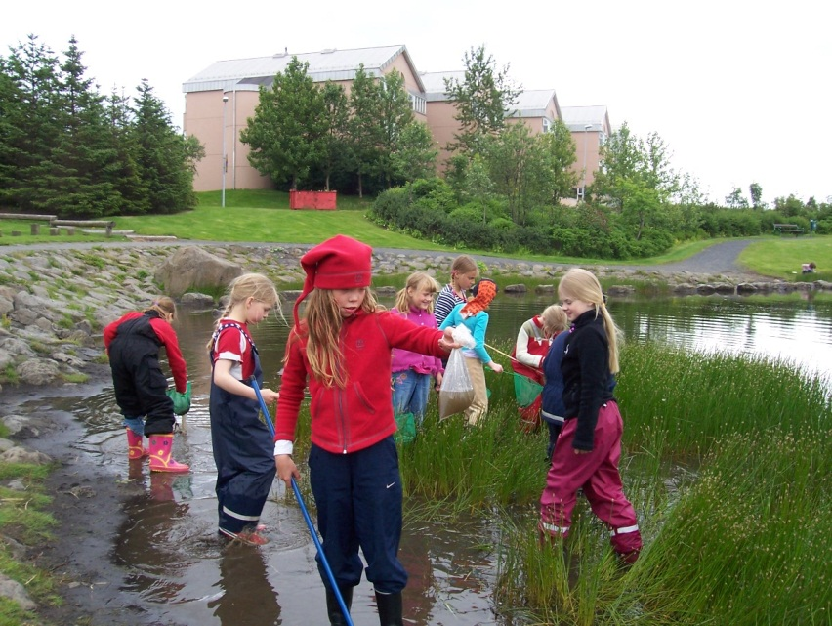
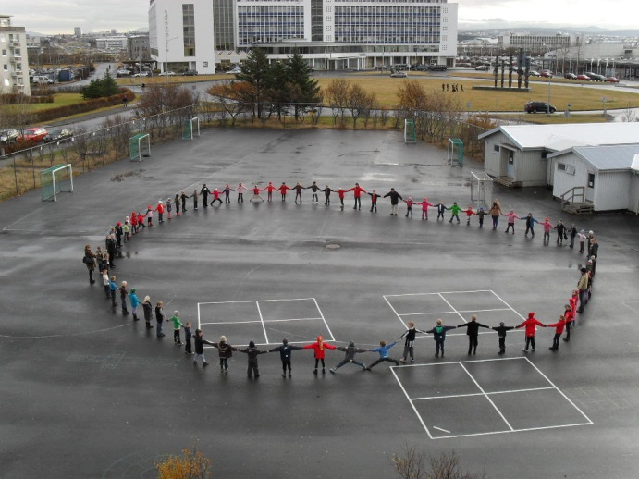
Youth and Leisure in Reykjavik

Slide 19
Cooperation with sport clubs and organisations
Leisure card
  476 $ per year
  6-18 year olds
  Courses and/or workshops should be a minimum of at least 10 weeks per term.
Leisure bus
  6-9 year olds
  Before parents come home from work
Most children and adolecents have finished their school, sport and leisure before 19:00, the youngest earlier.

Slide 20
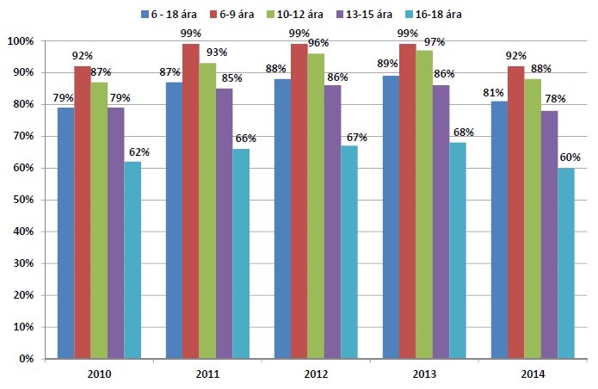
The proportion of children and adolescents in leisure activities in Reykjavik by year and age

Slide 21
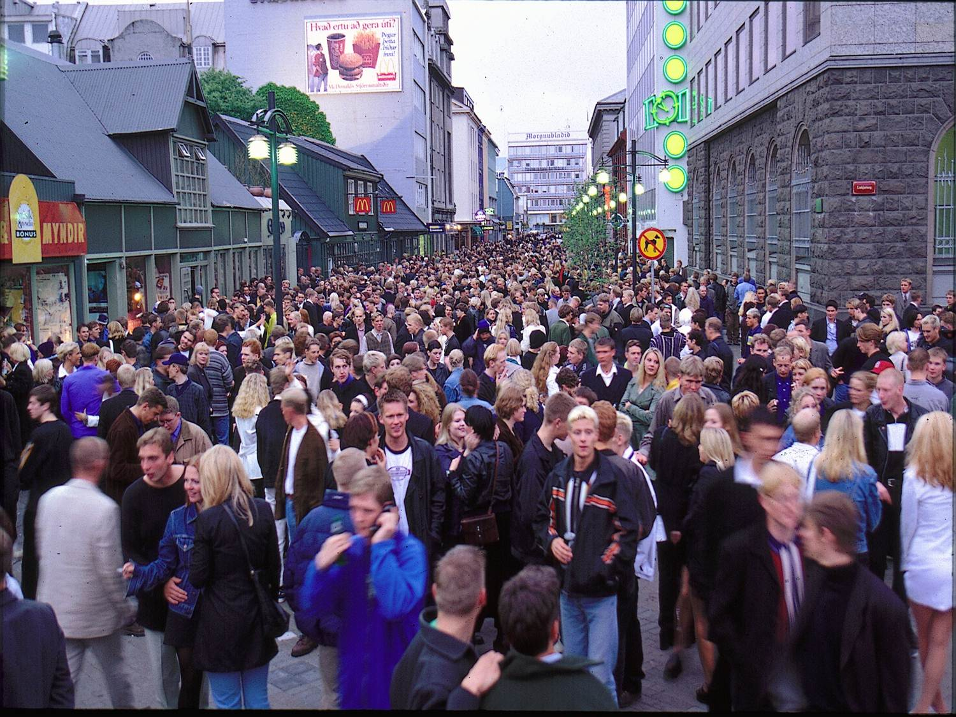

Slide 22
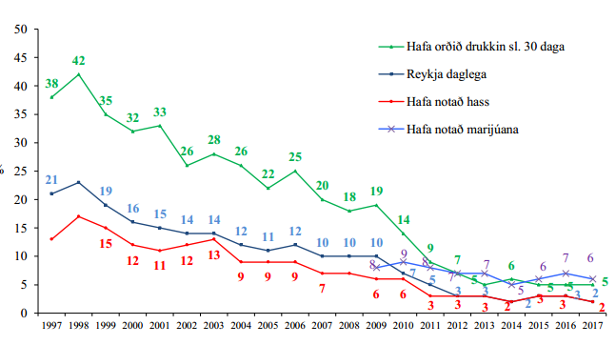
Percentage of 10th grade students in Reykjavik schools, smoking daily (dark blue line) , beeing drunk (green line) the last 30 days and used narcotics once or more in their lifetime ( red line hassish and blue mariuana/kanabish)- 1997-2017

Slide 23
Children and Youth in Reykjavik
Achieve Success
Around 90% of parents say that after-school programs and youth centers have positive influence on their children social competence.
Around 80% of youth aged 13-15 take part in some form of leisure activities.
We have good results in our schools where monitoring methods and prevention policy has significantly decreased student use of alcohol, drugs and smoking.

Slide 24
The objective in compulory education regarding prevention against drugs and abuse
All schools are entitled to have their own protection plan built on Reykjavik´s protection policy (since 2005)
All teachers are expected to follow instructions laid down in the plan if they suspect their students are having difficulties
All schools have school counsellors that guide the students and look out for troubles to be able to prevent them before they go too far
Regular meetings with schoolstaff and the staff of Youth center to analyse the outcome of the researches to organize cooperation.

Slide 25
Börnin í borginni/Children in the City
Depression 2008
Cooperation
  School (principle and teacher, preschool and compulsory), youth worker, socialworker (Welfare) kulture sector, mayors office, parents organization etc
  Meeting every month for the first years, just focusing on the childrens well being, food, poverty, partisipation in sports and leisure, art/museums (Childrens festival) a lot of support from the Welfare system.
  Now we meet 2 a year
  Rapport to the Mayor and Welfare Department one a year. Now we are facing more anxiety among children and more cap financially between classes.

Slide 26
Research and cooperation - the whole community! Protective factors
Outdoor time for children under 16 years old.
Support parents and help them to work together f.ex. “parentwalk”
The fight against unattended parties
Important for parents to know the friends of their children and the friends parents
Co-operation between schools, youth centers, police, parents and social authorities
Participation in organized leisure activities

Slide 27
